Slide 1
Morse Code Challenge – Oct 16
Agenda
Coding Challenge: Morse Code
Complete by Today – Level 4
Complete by Tomorrow – Level 3
Complete by Wednesday – Level 2 / 1
Module Work
Upload Work Done So Far
Work on Past Modules ONLY WHEN Morse Code is Complete
Upcoming
Tomorrow & Wednesday: Morse Code Challenge

Slide 2
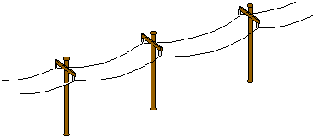
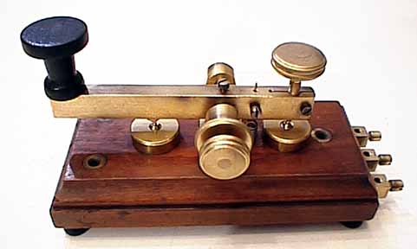
Computers & Communication
What came before the Internet?

Slide 3
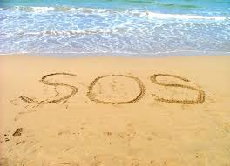
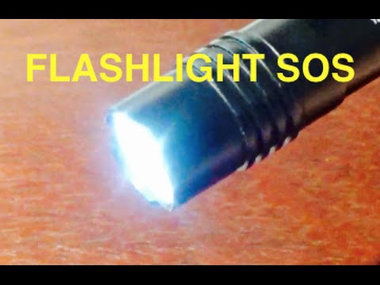
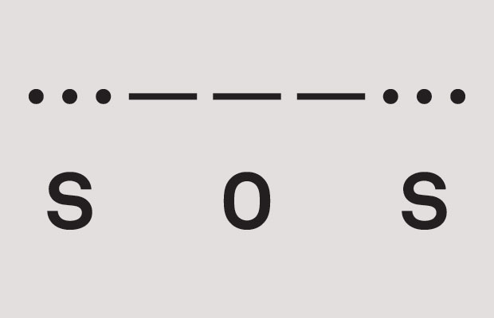
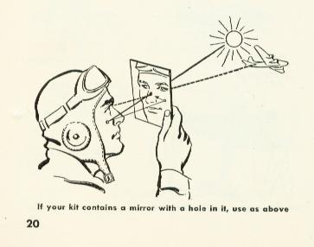
Save Our Souls (Universal Distress Signal)

Slide 4
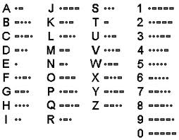
Morse Code

Slide 5
History of Morse Code
https://www.youtube.com/watch?v=bNoOYeS0gs0

